Slide 1
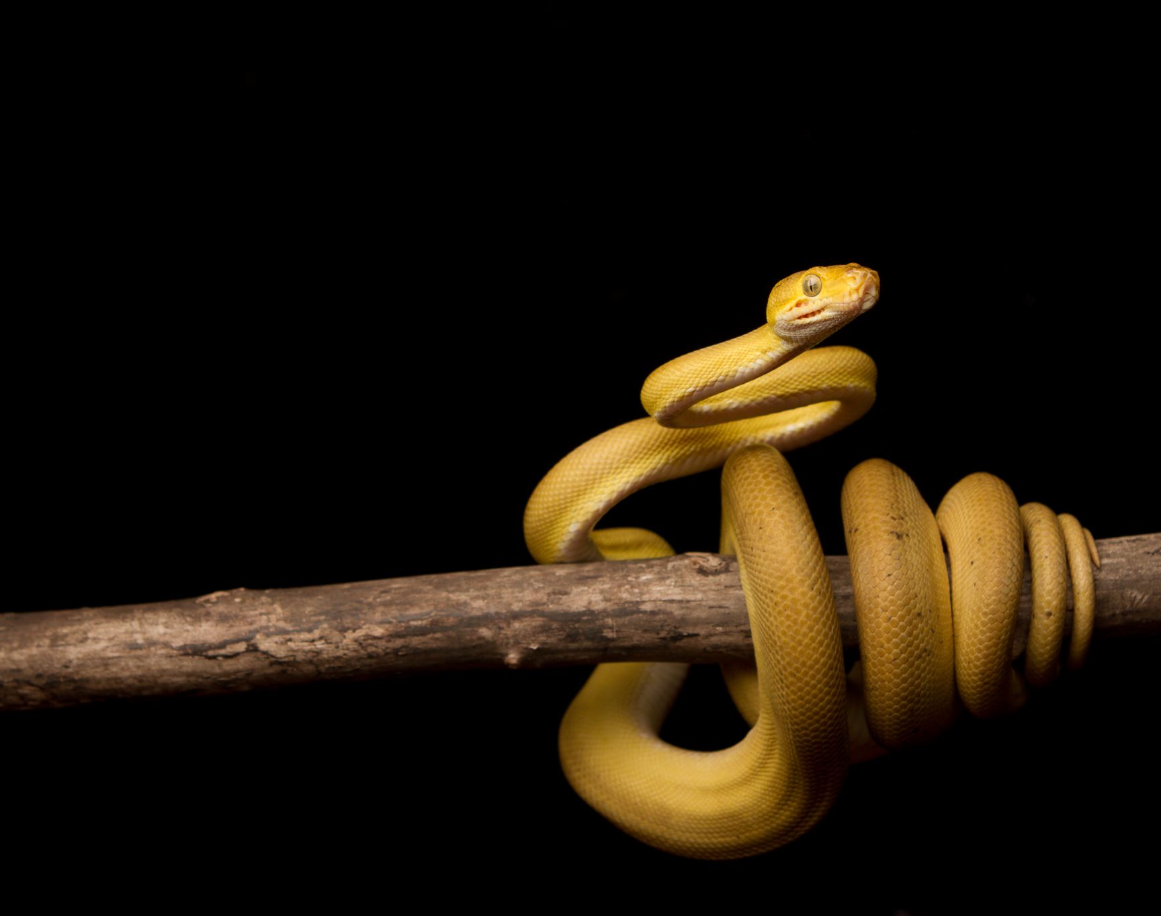
Python
Functions & Recursion
Chp 9 in book

Slide 2
Functions
Sometimes in code we repeat the same piece of code many times
We can copy & paste this piece of code again and again but this is time-consuming, makes the code hard to read.
It is very time-consuming to update the code if each piece has to be fixed
We can overcome all these difficulties using functions
A function is a self-contained piece of code that carries out a specific task.

Slide 3
Functions
A function is a self-contained piece of code that carries out a specific task
Functions allow is to do MODULAR programming where the program is separated into independent modules/pieces, each of which perform a specific task.
Functions are re-usable

Slide 4
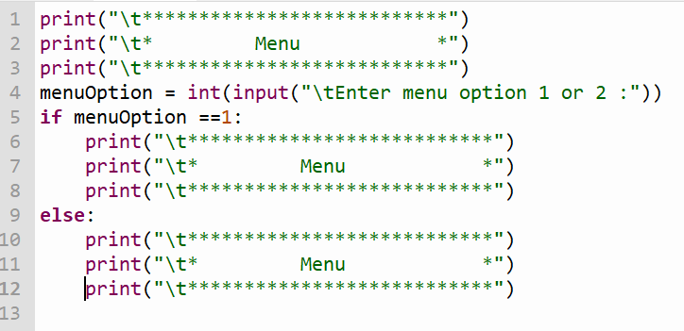
Functions – Defining and calling a function
There are many built-in functions in python e.g. print()
The first 3 lines of code are repeated 3 times. We can define our own function for the menu

Slide 5
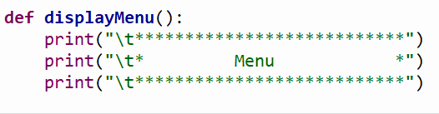
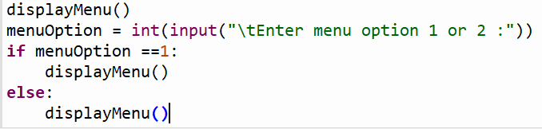
Functions – Defining and calling a function
- The first line of code contains the keyword def, the name of the function followed by a pair of brackets and semi-colon.
- It is followed by an indented block of code known as the function body.
This definition on its own WILL NOT run UNTIL it is called elsewhere in the code.
- The function must be defined before it can be called
- To call the function, type the name of the function followed by brackets

Slide 6
Functions – with arguments
An argument is a variable or constant that can be passed into the function, for manipulation or use.
BEFORE WRITING A FUNCTION, ITS GOOD PRACTICE TO DECIDE ON THREE THINGS
  A suitable name for the function. The function name should be meaningful and start with a lowercase letter
  The arguments required for the function to carry out its task
  What the code body of the function consists of. This can be written as pseudocode first

Slide 7
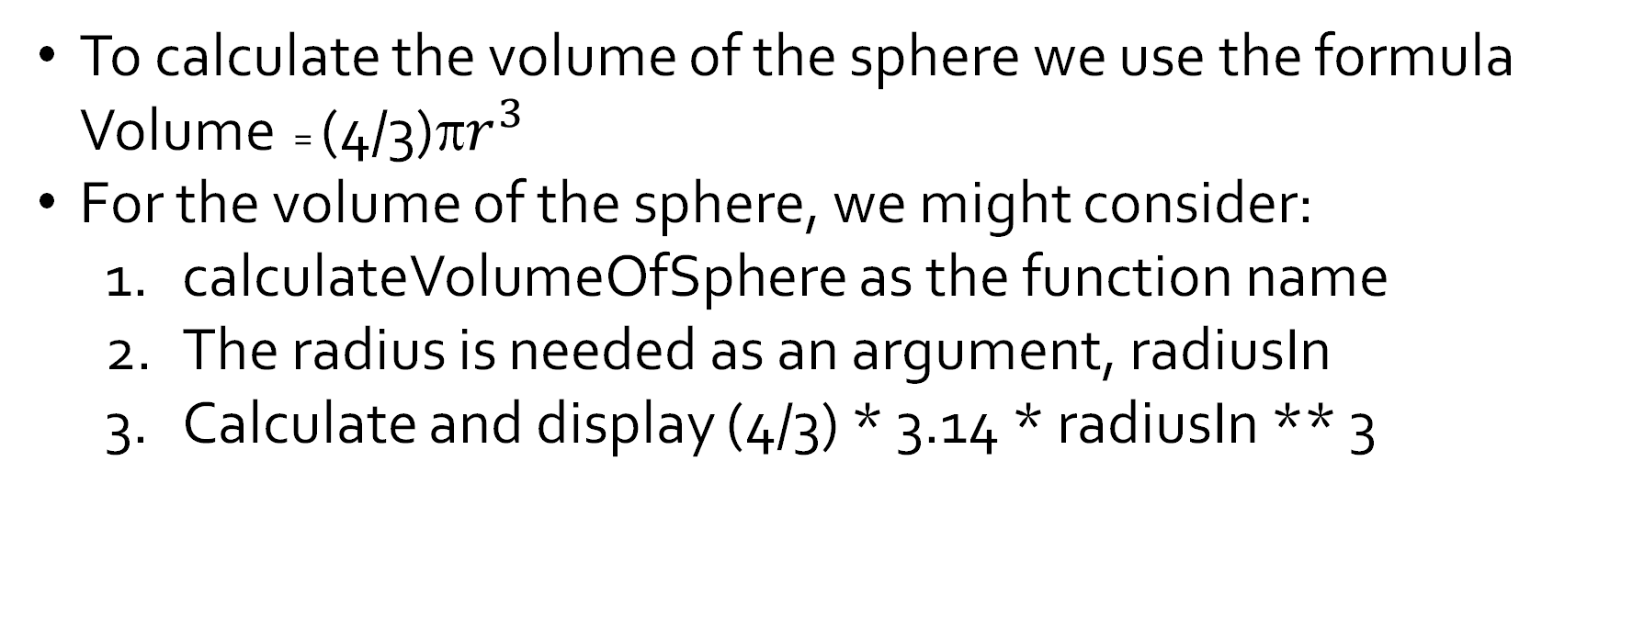
Functions – Calculate the volume of a sphere
To calculate the volume of the sphere we use the formula Volume = (4/3)π$r^{3}$
For the volume of the sphere, we might consider:
  calculateVolumeOfSphere as the function name
  The radius is needed as an argument, radiusIn
  Calculate and display (4/3) * 3.14 * radiusIn ** 3

Slide 8
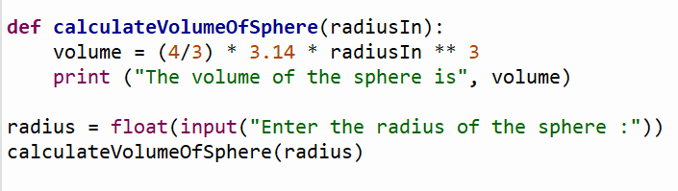
Functions – Calculate the volume of a sphere

Slide 9
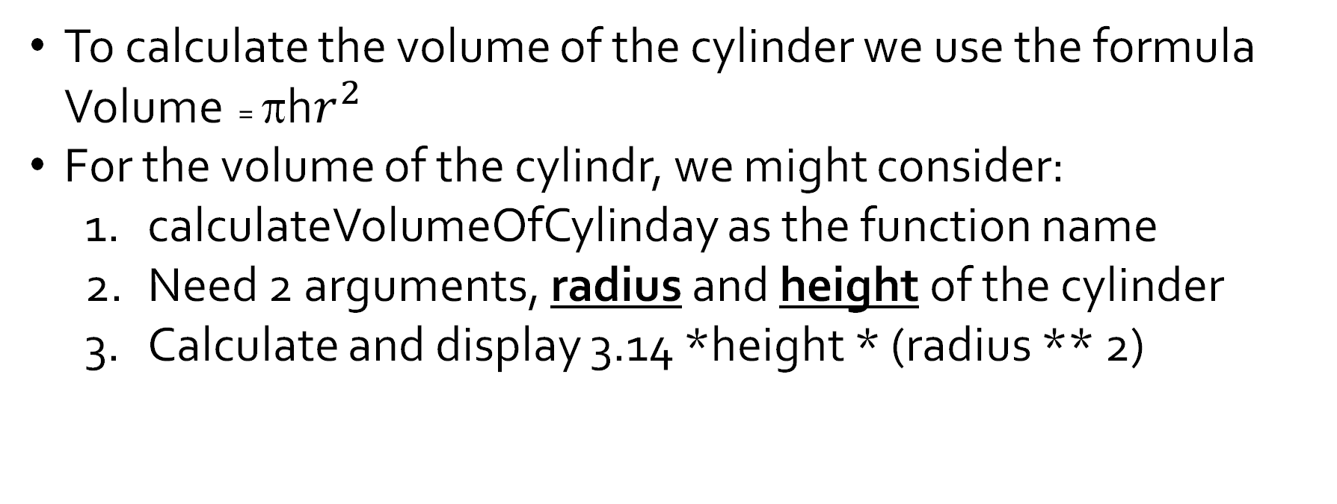
Functions – with multiple arguments -> calculate volume of cylinder
To calculate the volume of the cylinder we use the formula Volume = πh$r^{2}$
For the volume of the cylindr, we might consider:
  calculateVolumeOfCylinday as the function name
  Need 2 arguments, radius and height of the cylinder
  Calculate and display 3.14 *height * (radius ** 2)

Slide 10
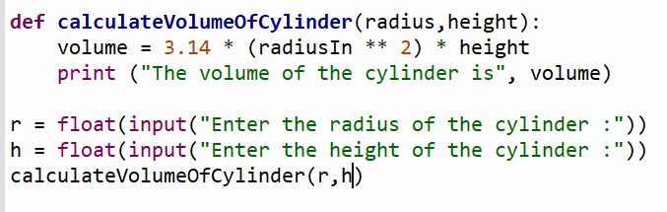
Functions – with multiple arguments -> calculate volume of cylinder

Slide 11
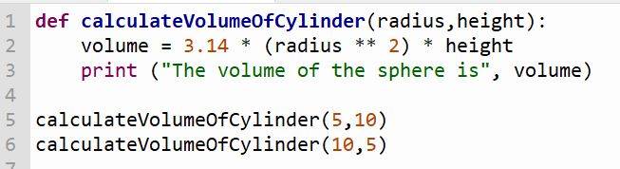
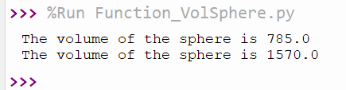
Functions – using arguments in different order
-When calling a function, the arguments MUST match the order used when defining the function.
We defined the function as calculateVolumeOfCylinder(radius,height). The first argument must be the radius and the second is height.

Slide 12
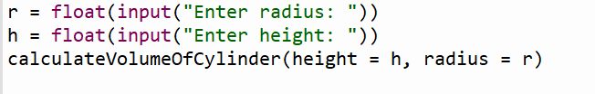
Functions – calling functions with keyword arguments
Using keyword arguments can help to ensure that arguments appear in the correct order when calling functions.
In this code, height=h and radius=r are referred to as key arguments. We use them to explicitly state which arguments the values are intended for. This means the order of the arguments doesn’t matter

Slide 13
Functions – Practice Time Pg 199 Q1 – Q5
Write a python function to display a happy birthday message and call this function 3 times.
Write a function to calculate and display the value of pi. Use (22/7) to calculate pi
Write a function that takes in 2 numbers multiplies them and displays the number

Slide 14
Functions – Practice Time Pg 199 Q1 – Q5
Write a python function that take in 2 arguments, the base number and the index number. The function calculates the base number raised to the power of the index number
Write a python function to take in 2 integers as arguments, check which one is larger and display the larger valuewith a relevant message

Slide 15
Functions – that return a value
The above function uses the print() function to display the volume of the sphere.
However, we may not want to display the result or we may want to use the result of the function for something else in the main program. To achieve this we can have the function return a value to the main program body

Slide 16
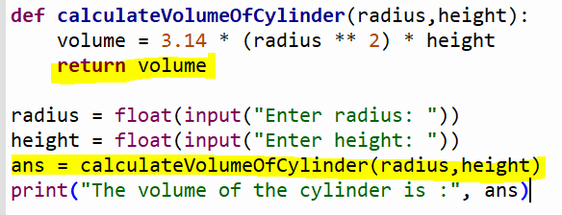
Functions – that return a value
Sometimes we use the result of the function for something else in the main program.
To achieve this we can have the function return a value to the main program body

Slide 17
Functions – Practice Time Pg 199 Q1 – Q5
  A suitable name for the function. The function name should be meaningful and start with a lowercase letter
  The arguments required for the function to carry out its task
  What the code body of the function consists of. This can be written as pseudocode first
  The value (if any) that the function will return

Slide 18
Functions – that return a Boolean value
AN EXAMPLE – Websites often have to validate email addresses over and over again. We can write this as a function in python
The function name is validateEmail()
The argument is the email address as a string.
The function tests that the email adddress given contains:
  At least one “.”
  Exactly one “@”
  At least eight characters
The function returns true or false to represent whether the email address is valid or not

Slide 19
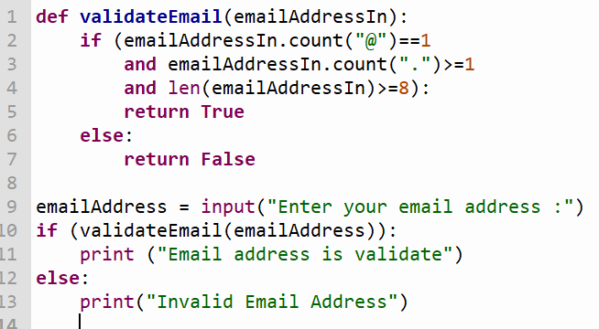
Functions – that return a Boolean value
-The function returns True if the argument satisfies all three requirements.
Otherwise it returns a False

Slide 20
Practice & Homework
– pg 203 Tasks 1 to 8 inclusive

Slide 21
Local & Global Variables
Global variables are those which are not defined inside any function and have a global scope and they are available for use throughout the program and inside every function
Local variables are those which are defined inside a function and its scope is limited to that function only. They belong only to that function. It cannot be accessed anywhere outside the function

Slide 22
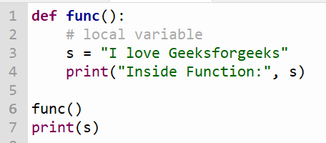
Local & Global Variables

Slide 23
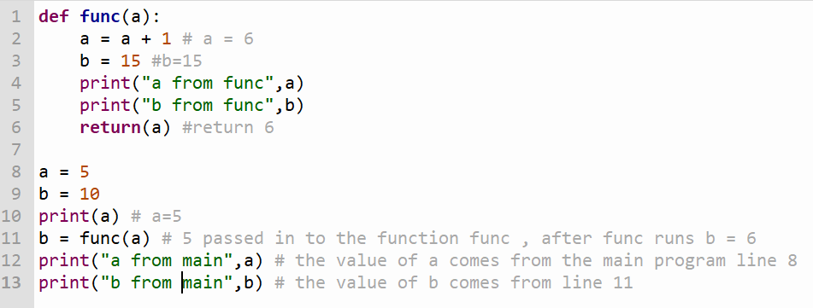
Local & Global Variables

Slide 24
Local & Global Variables
https://www.youtube.com/watch?v=A054Ged9suI
Video explaining the differences between local and global variables

Slide 25
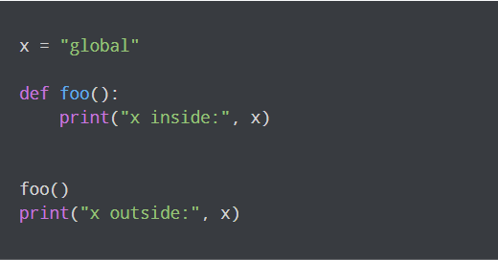
Predict the output

Slide 26
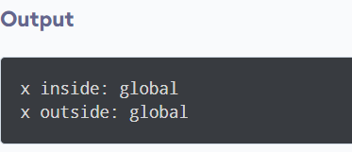
The Output

Slide 27
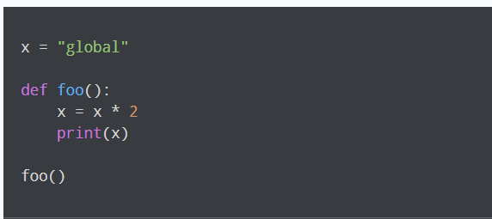
Type and run this code

Slide 28
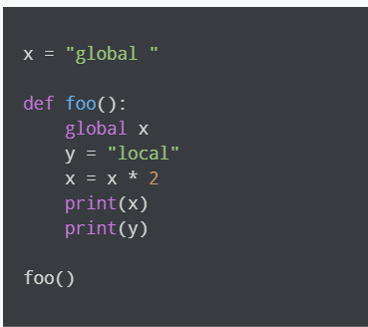
Predict the output

Slide 29
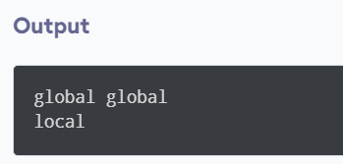
The Output

Slide 30
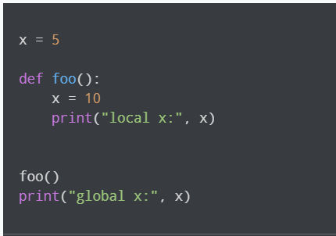
Predict the output

Slide 31
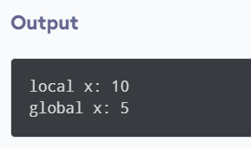
The Output

Slide 32
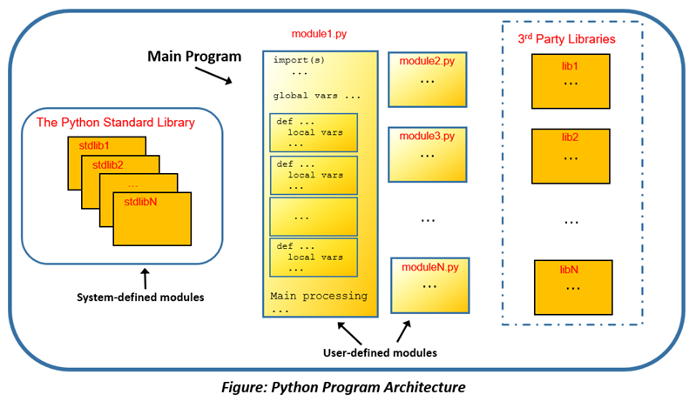
Python is Modular
Python is a collection of modules.
Modules are individual python script files (files with .py ending) that are made up mostly of functions

Slide 33
Python is Modular
Python is a collection of modules. Modules can be classified into 3 groups:
User-defined modules -> modules written by the programmer as part of the program being developed
Standard library modules -> These are modules that come preinstalled as part of python e.g. math, random,
3rd party modules -> These are developed by an external source either for commercial purposes or as open source. There are literally thousands of these e.g numpy, plotly, django

Slide 34
Python file organisation
Python files are typically organised into 3 sections
Import section at the top
Function section where all the functions are defined
The main program -> where the program execution begins

Slide 35
Python file organisation
Python files are typically organised into 3 sections
Import section at the top
Function section where all the functions are defined
The main program -> where the program execution begins

Slide 36
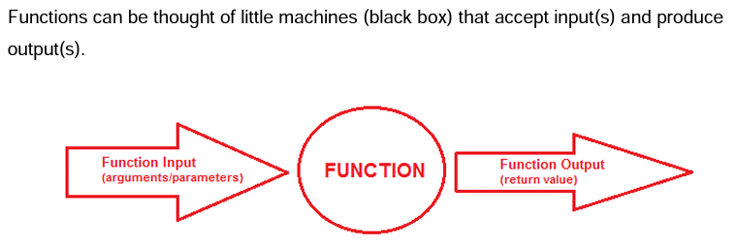
Function Return Values
Data is passed into the function through the use of arguments. Data is passed out of the function by use of the return statement

Slide 37
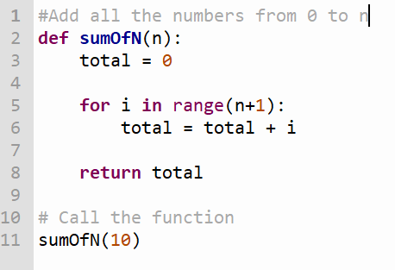
Function Return Values
The return value of a function can be saved for further processing by making the function call part of an assignment statement
Why does nothing appear to happen when you run this code?
Edit to code to make the total appear on screen.

Slide 38
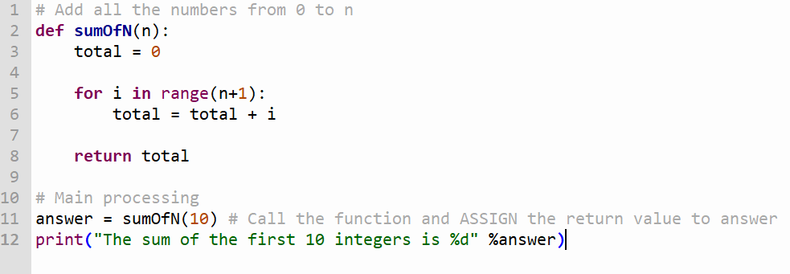
Function Return Values
When you want to save the return value of a function, the function call should be part of an assignment statement variable_name = function_call()

Slide 39
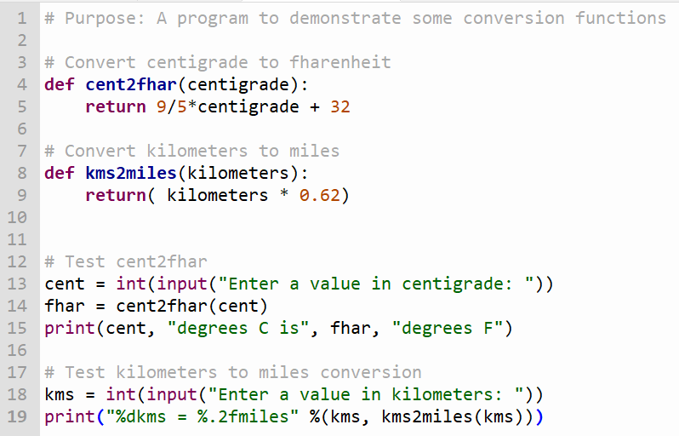
Function Return Values
1 - Modify the program so that the constant values e.g 9/5, 32 and 0.62 are stored in variables
2 – Extend the program with functions to convert from a) miles to km
b) Fahrenheit to centigrade

Slide 40
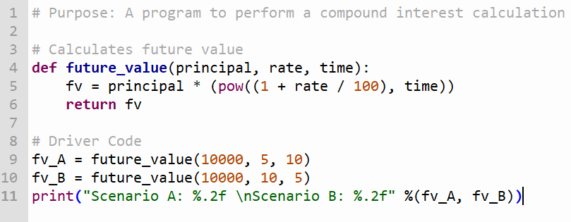
Function Return Values
Which will give greater return: €10,000 at a rate of 5% for 10cyears OR €10,000 at a rate of 10% for 5 years
- The formula FV=p(1+i)**t is used to calculate the compound interest
- pow(x,y)is a built-in function
1- Modify the code to take in user input for principal, time and rate
2 – Extend the program to compare compound interest with simple interest

Slide 41
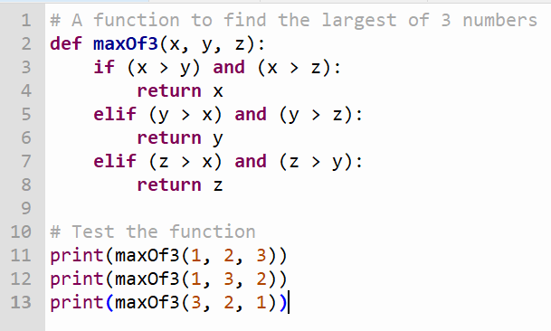
Function Return Values
1- Modify the code to take in 3 numbers from the user, displays the maximum in a meaningful message
2- Modify the code to take in 3 numbers from the user, display the minimium in a meaningful message

Slide 42
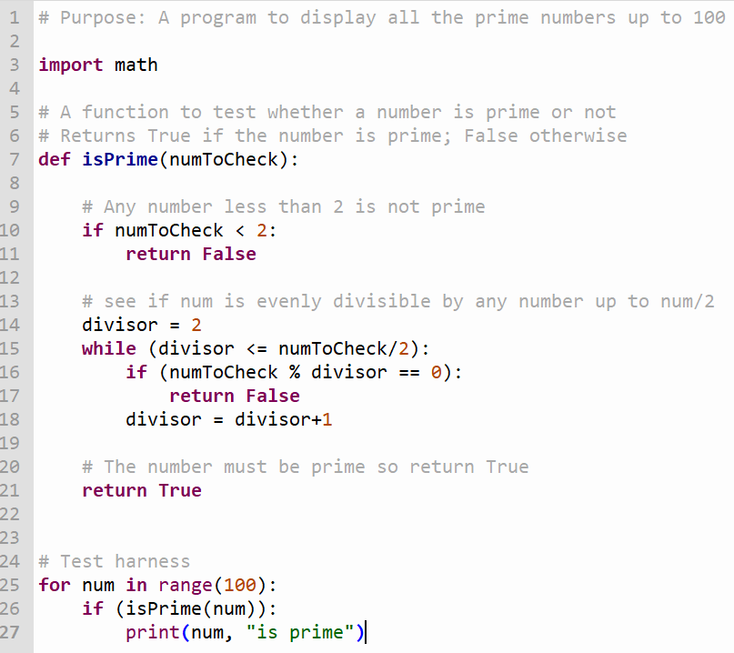
Function Return Values

Slide 43
A Prime Example Questions
Predict what the test harness would do
The program looks for factors up to half the number being checked. What would happen if the program stopped at the square root?
Modify the test harness so it displays the first 100 prime numbers
Make a program that displays the nth prime number entered by the end prime user

Slide 44
Recursion (Higher Level)
A recursive function is a function that is defined in terms of itself
In maths there are many examples of expressions written in terms of themselves, such as factorial n or n!
factorial (n) = n x factorial(n-1)
Recursion is a method of solving a problem where the solution depends on the solutions to smaller subsets of the same problem

Slide 45
Recursion (Higher Level)
A recursive function is a function that is defined in terms of itself
Example -> . It is the product of all integers from n down to 1 where 0! has the value 1.
n! = n x (n-1) x (n-2) x (n-3) x (n-4)…..x 3 x 2 x 1 for all n > 0 and 0! = 1
5! = 5 x 4 x 3 x 2 x 1 =120

Slide 46
Recursion (Higher Level)
factorial (n) = n x factorial(n-1)
n! = n x (n-1)!
A recursive function is a function that calls itself. The problem is continuously broken down into smaller subsets of itself, until a stopping point is reached. This is the base case. Every chain of recursive calls MUST reach a base case

Slide 47
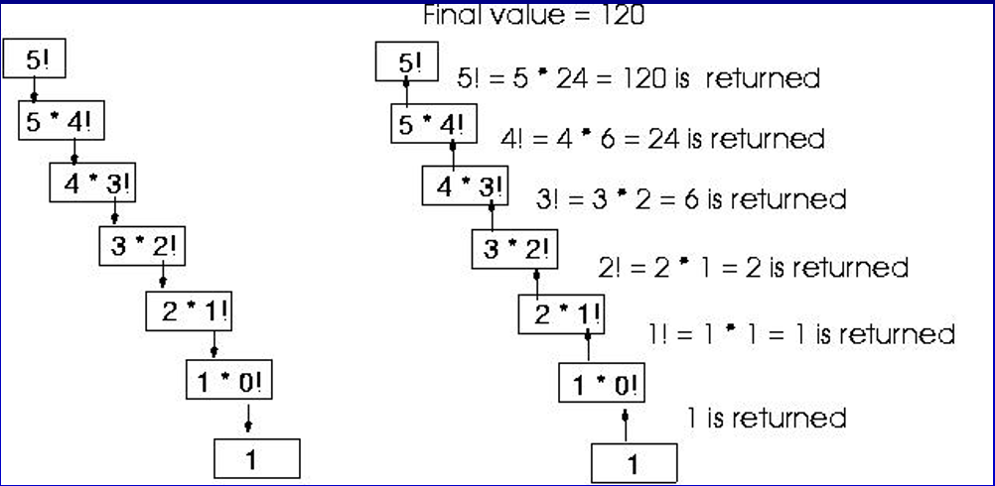
Lets see how 5! would be evaluated recursively

Slide 48
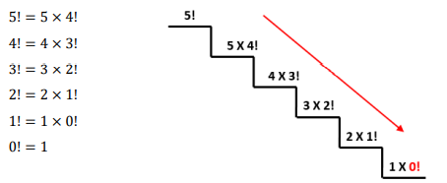
Recursion (Higher Level)
Evaluating 5! Can be considered in 2 stages. In the first stage, the number whose factorial is being sought is being multiplied by the factorial of the previous number. The chain of operations continues until 0! is reached

Slide 49
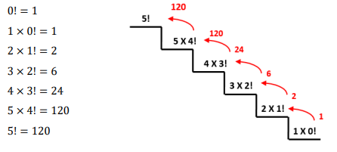
Recursion (Higher Level)
In the second stage of the evaluation, the chain starts at the evaluation of 0! = 1 (the base case). This results in the completion of each successive step up the chain until 5!is reached

Slide 50
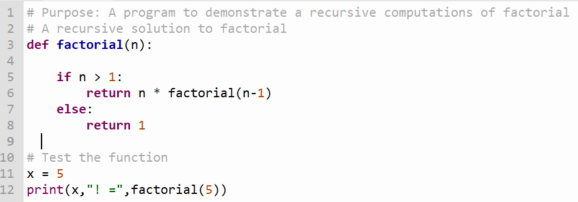
Recursion (Higher Level)
Recursion is considered to be computationally expensive because it requires relatively large amounts of memory to complete. In python a recursive function can only call itself 1000 times and then python stops it

Slide 51
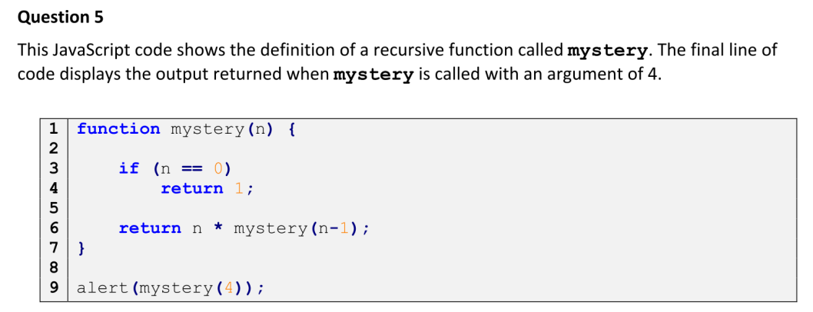
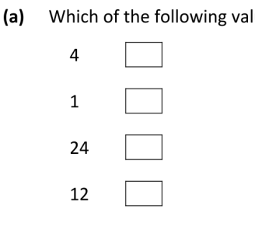
Recursion (Higher Level)

Slide 52
Recursion (Higher Level)
To Summarise, a recursive function has 4 parts:
Defining the recursive function
Defining the base case
Specifying the value that must be returned when the base case is reached
Specifying the operation that must be carried out with each returned value

Slide 53
Recursion Question Task 1 pg 209
A Fibonacci sequence is a sequence of numbers where the first 2 terms are 0 and 1 and the next terms in the sequence are the results of adding the last 2 numbers together. For example 0,1,1,2,3,5,8,13,….
Write a Fibonacci function in Python using recursion.
Step 1: Define the recursive function
Fib(n) = fib(n-1) + fib(n-2)

Slide 54
Recursion Question Task 1 pg 209
A Fibonacci sequence is a sequence of numbers where the first 2 terms are 0 and 1 and the next terms in the sequence are the results of adding the last 2 numbers together. For example 1,1,2,3,5,8,13,….
Write a Fibonacci function in Python using recursion.
Step 2: Define the base case
Fib(0)

Slide 55
Recursion Question Task 1 pg 209
A Fibonacci sequence is a sequence of numbers where the first 2 terms are 0 and 1 and the next terms in the sequence are the results of adding the last 2 numbers together. For example 1,1,2,3,5,8,13,….
Write a Fibonacci function in Python using recursion.
Step 3: Specify the value that must be returned when the base case is reached
Fib(0) = 1

Slide 56
Recursion Question Task 1 pg 209
A Fibonacci sequence is a sequence of numbers where the first 2 terms are 0 and 1 and the next terms in the sequence are the results of adding the last 2 numbers together. For example 1,1,2,3,5,8,13,….
Write a Fibonacci function in Python using recursion.
Step 4:Specifying the operation that must be carried out with each returned value
The operation is ADDITION

Slide 57
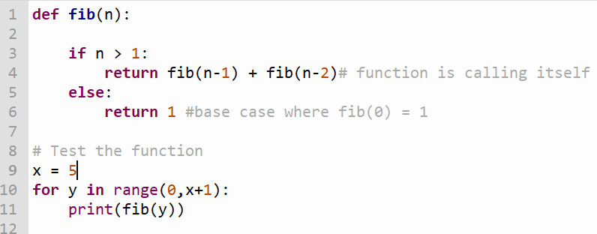
Recursion Question Task 1 pg 209

Slide 58
Recursion (Higher Level)
https://www.youtube.com/watch?v=ngCos392W4w

